Slide 1

Extra Duty Workflow Changes
TIMEKEEPERS
Notes:
Why the crown? Because y’all are “ROYALLY AWESOME” for all the things you do!

Slide 2
What is changing and why?
What is NOT changing?
Extra Duty names
Cost Center Managers
Workflow process
Comments
How an employee clocks in/out for Extra Duty
Process for timesheets that do not have any Extra Duty entries
Time Off requests
Change Requests
Notes:
CHANGING:
*Extra Duty names: to better reflect who the employee is working for and better describe when to apply Workshop versus Hourly rates of pay
*Cost Center Managers: additional approver who is responsible for specific Extra Duties
*Workflow: after an employee submits their timesheet, those who offered Extra Duty will see it first to verify time and add coding before the employee’s home/default Timekeeper/Supervisor.
*Comments: if changes are made directly to an employee’s timesheet, comments will be required (beginning July 1st)
NOT CHANGING:
*Employees still clock in AND out for Extra Duty. To clock in, use the Extra Duty button. To clock out, use the Punch In/Out button. EMPHASIS is on the Extra Duty selection.
*Employee only works scheduled hours (no Summer School or Extra Duty) - looks the same, handled the same
*Time Off requests are the same
*Change Requests are currently the same; will need to be processed timely

Slide 3
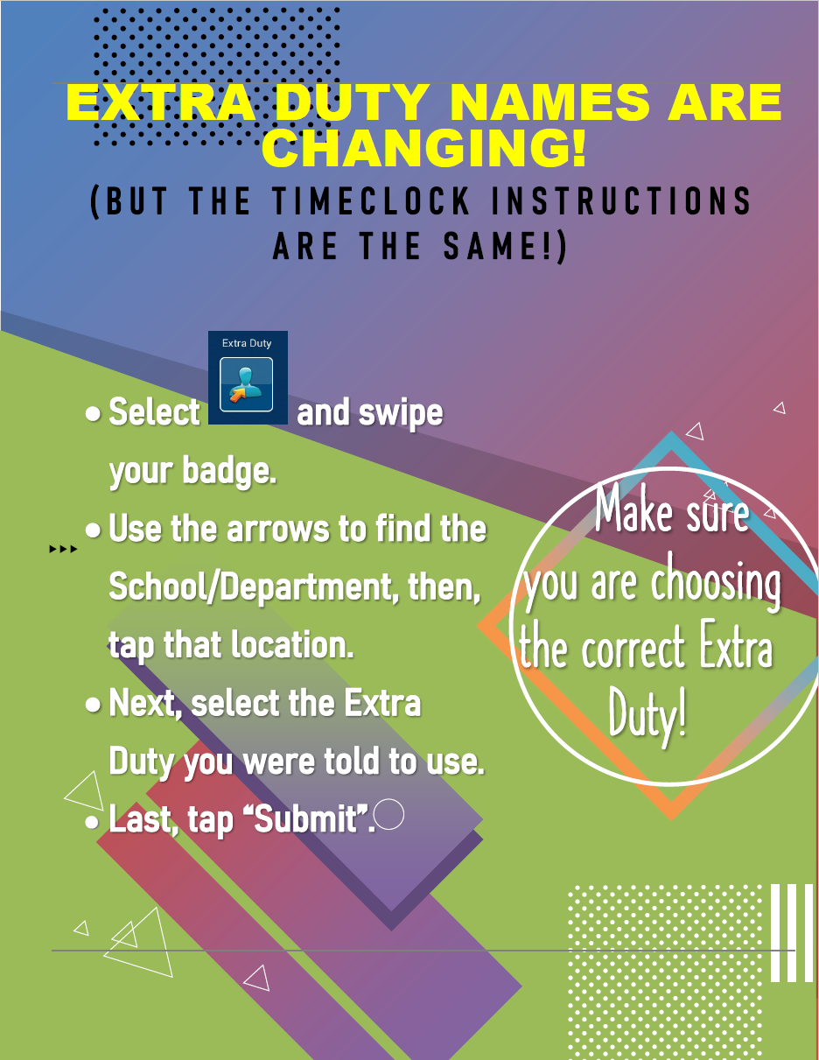
Please print and place this flyer by each timeclock and in common areas.
Notes:
Help me, help you, help the employee….you’ll hear me say it often through the presentation-by the employee selecting the correct Extra Duty and submitting their timesheet, this process will become smoother more quickly.

Slide 4
HELP!!!
(Training items)
Notes:
Recurring theme I’ve heard is how much people want training. Working to make this better and easier so let me show you what’s available now.

Slide 5
In-Person/Virtual Meeting
On-demand
-June and July: more targeted, smaller groups
-Upon request
-Payroll website
-Reference docs
What about the employees? Who do they go to for questions?
An employee should see their Timekeeper and/or Supervisor first for training and assistance.
Notes:
I’ll be setting up invites in the near future for the additional trainings in June and July. I anticipate grouping (levels, size of participants, location, etc.) to help make the most of everyone’s availability and attention spans. Between now and start of school, the “Upon Requests” will take into account what the need and availability is.
Reference docs from the prior email (which will be readded when I send out the information from these meetings).
As for the employees, their first point of information is their worksite so Timekeepers and Supervisors would still be training employees to use Kronos.

Slide 6
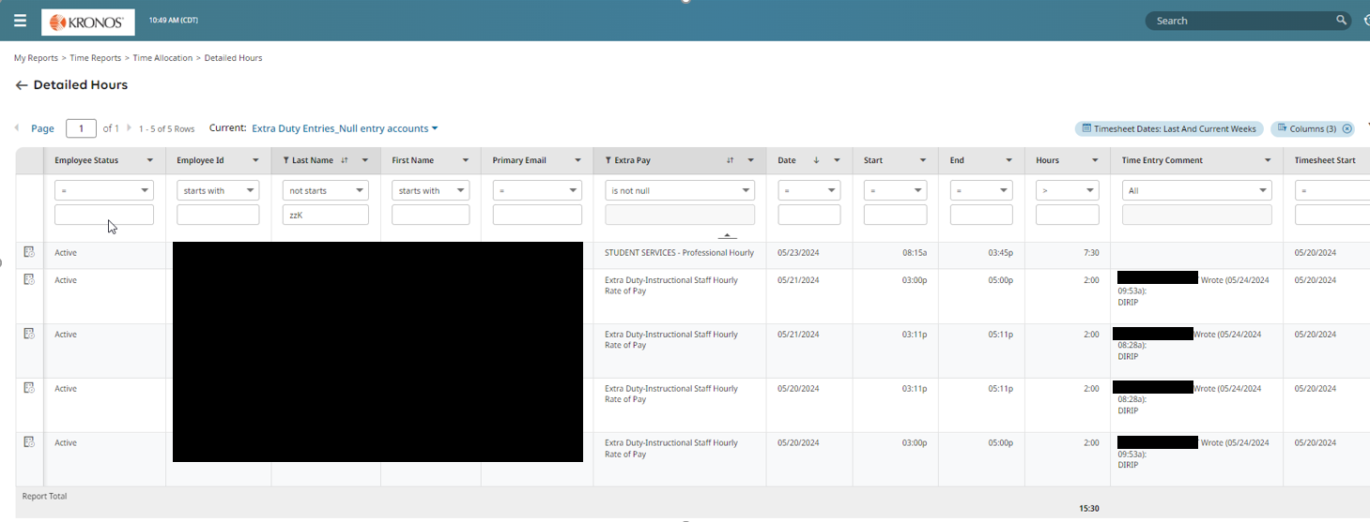
Helpful report for Extra Duty
“Extra Duty Entries_Null entry accounts”
-Shows you what Extra Duties your employees have selected for a given time period.
-Can be run on demand or scheduled.
Notes:
Already have access to this under Reports>My Saved Reports but separate instruction document coming out

Slide 7
Need help?
-Account Coding: Budgeting Department (https://www.escambiaschools.org/budgeting)
-Timesheet Issues: Payroll (https://www.escambiaschools.org/payroll)
-Request for training/Questions: Payroll/Anya Klinginsmith/Dasia Williams
-Who is responsible for a Extra Duty: Cost Center Manager directory (available on Payroll website)
-Badge malfunction/Timeclock issues: ithelp@ecsdfl.us

Slide 8
Employee

Slide 9
What is the employee responsible for?
-Clocking in/out for scheduled time (depending on employee type)
-Clocking in & out for Extra Duty
-Extra Duty selection
-Adding notes (when required)
-Submit timesheets
-Change Requests
-Time Off requests
Notes:
All the same responsibilities.

Slide 10
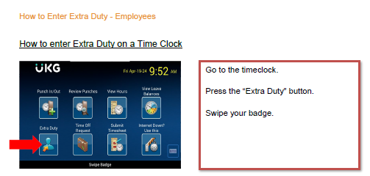
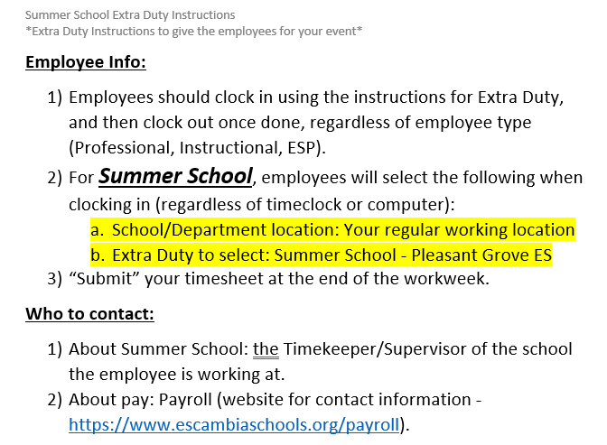
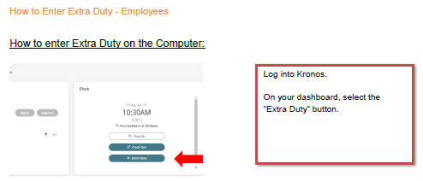
What does it look like?

Slide 11
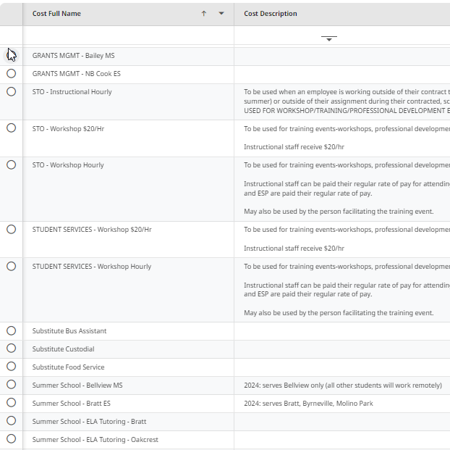
Notes:
Extra Duty options will be limited by the employee’s position type - administrative, instructional, professional, ESP. If a group cannot use the Extra Duty, it will not be visible to them, nor can it be selected for them by a Cost Center Manager, Timekeeper, or Supervisor. As we move through this process, these will be refined and descriptions updated. This is the view from an Instructional perspective-you do not see any mention of Professional or ESP.
The directory of Cost Center Managers will be updated regularly and will be found on the Payroll website.
Again, it is important the employee selects the correct Extra Duty-doing so helps ensure they are paid timely because if they’re wrong-it can take a bit to get it all sorted and corrected.

Slide 12
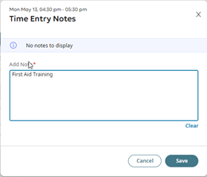
Adding a Note (if needed):
Notes:
Employees may be asked to add notes for their Extra Duty (name of training, for example). This is done directly on the employee’s timesheet.

Slide 13
Cost Center Managers

Slide 14
What Are the Cost Center Managers Responsible For?
-Work with Finance Depts to set up Extra Duty
-Provide instructions to employees on what School/Department location and Extra Duty should be selected
-Instruct employees what to add as a note on the timesheet (if needed)
-Limited corrections of Time Entry fields
Verification of Time Entry for selected Extra Duty
Add coding
Approve/Submit the Time Entries
-Review reports as needed to be proactive and also correct issues
Common questions:
Can I (a Timekeeper) also be a Cost Center Manager? YES
What? Why? How? Possible ways: (a) If the employee works at your site, then you would be the person who could verify their time entries; (b) If your site is given money to handle your own Extra Duty (ex: Workshop), then you would be responsible for the time verification and coding.
Notes:
Cost Center Managers are receiving their own training and some of you may have been part of it from the Summer School perspective.

Slide 15
Timekeepers

Slide 16
What is the Timekeeper Responsible for?
What is the Timekeeper NOT Responsible for?
-Remind employees to:
Select the correct Extra Duty
Clock in and out for Extra Duty
Add notes (if needed)
Submit timesheets
-Approve Change Requests
-Time Off requests
-Internal Funds tab entries
-Processing Timesheets and Time Entries by the posted deadlines of Payroll
-MAY attach documents/notes to the timesheet
-MAY be asked to assist Cost Center Managers
-IF it is a “School-funded” Extra Duty, then you may step into a Cost Center Manager role
-Adding comments if you make a change directly to the employee’s timesheet (as of July 1st)
-Entering Extra Duty on behalf of the employee (exception: Internal Funds tab)
-Unless asked/needed, should not be modifying Department Extra Duties
Notes:
Many of the same responsibilities are in place. As we move along in the process, Timekeepers should be relying on the Cost Center Managers to manage the Extra Duties-add coding, verify time, etc. This is especially true for Summer School and those departments that are early adopting until July 1st.
Generally speaking, the Supervisor could be responsible for the same things as a Timekeeper. What you see will vary by how your location is set up.

Slide 17
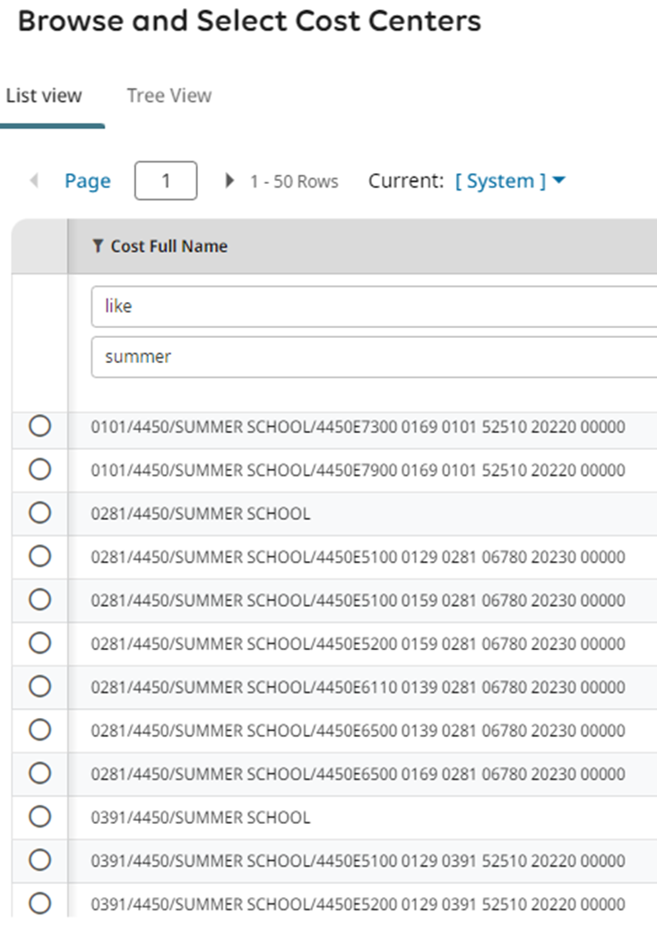
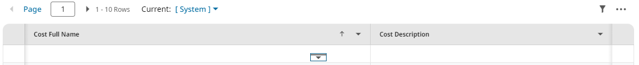
Account Coding
-Filtering is your friend when searching for Account Coding.
-Be EXTRA CAUTIOUS WHEN SELECTING CODING during the summer months: you will see more than one location since many employees are working at different locations.
Pro-tip: use “like” to narrow your search.
“0101” is Bratt
“0281” is Escambia HS
Pro-tip: click on this icon to expand the view and have filtering options.
“0391” is Oakcrest
Notes:
Filtering is available for Extra Duty options, reports, School/Department locations, Account coding-many places in Kronos

Slide 18
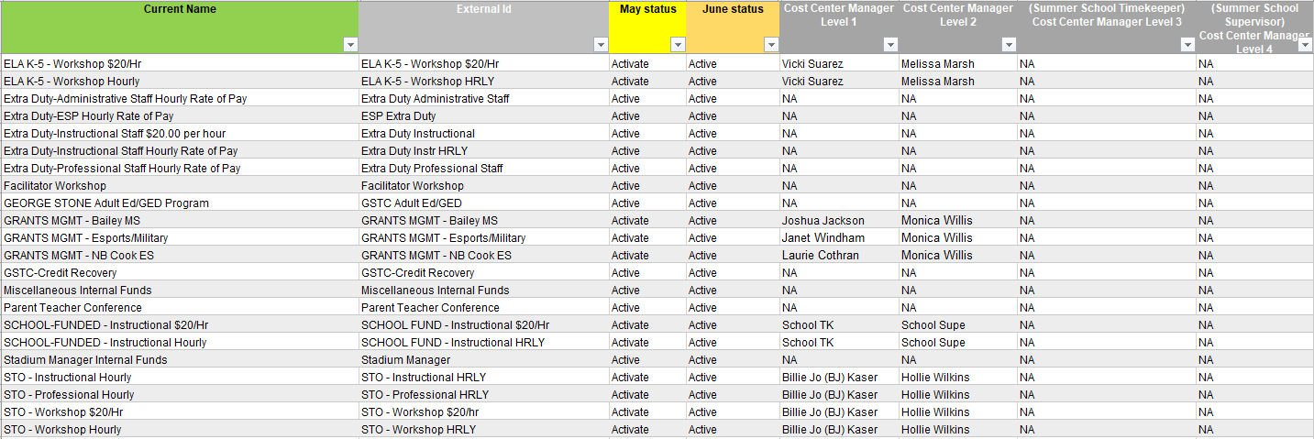
Directory for Extra Duty
-For May/June: If there isn’t a name listed, the Extra Duty will be handled by the employee’s home/default Timekeeper/Supervisor to add coding.
-July changes: adding some, removing others, changing names, adding descriptions (as needed)
-There will be an additional column providing the former name. As we continue into the new school year, that will eventually drop off.

Slide 19
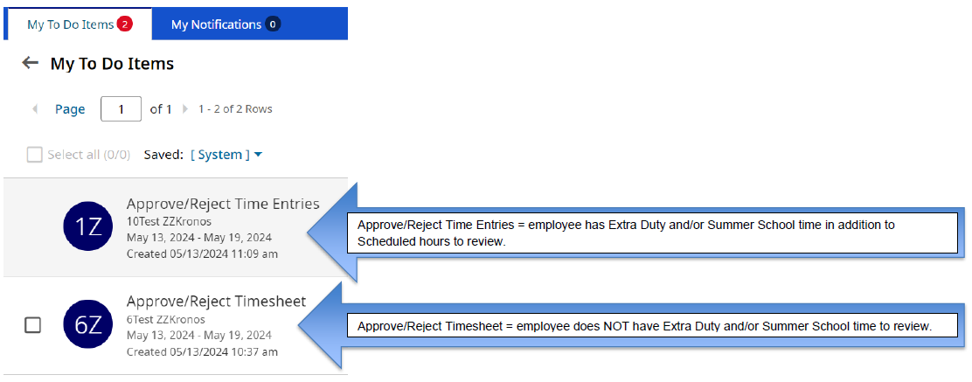
Approving Time Entries vs. Timesheets
Notes:
Key differences between Time Entries and Timesheets: loss of “checkbox” and name. I go to “My Mailbox” to see this information.

Slide 20
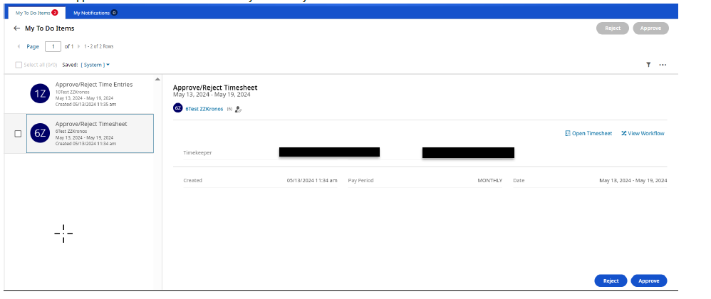
Timesheet view
Notes:
Timesheet view-have Timekeeper/Supervisor information (a few places only have a Supervisor so the Timekeeper will not be listed).
Can still process as usual directly from this screen or in the timesheet.

Slide 21
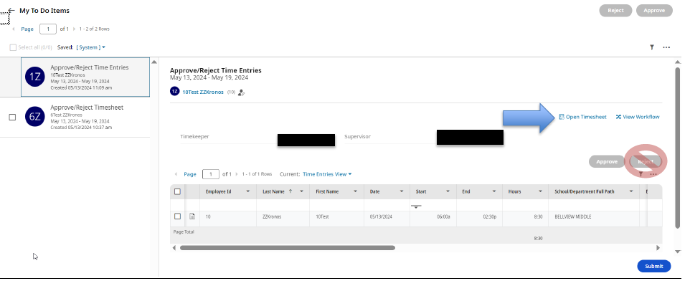
Time Entry view
Notes:
Time Entries view-have the Timekeeper/Supervisor information as well.
More views/information in the “Extra Duty Instructions for Timekeepers” document.
The entries you see in this view are related to the employee’s scheduled hours.
AS A TIMEKEEPER, you can Reject the Time Entries but it does restart the workflow for everyone. If corrections are needed, still open the Timesheet to do so. Unless asked, in general, department Extra Duty entries should not be touched - AFTER the employee submits their timesheet, the time entries go to the Cost Center Managers first.

Slide 22
Supervisors

Slide 23
What is the Supervisor Responsible for?
What is the Supervisor NOT Responsible for?
-MAY attach documents/notes to the timesheet
-MAY be asked to assist Cost Center Managers
-IF it is a “School-funded” Extra Duty, then you may step into a Cost Center Manager role
-Adding comments if you make a change directly to the employee’s timesheet (as of July 1st)
-Remind employees to:
Select the correct Extra Duty
Clock in and out for Extra Duty
Add notes (if needed)
Submit timesheets
-Approve Change Requests
-Time Off requests
-Internal Funds tab entries
-Processing Timesheets and Time Entries by the posted deadlines of Payroll
-Entering Extra Duty on behalf of the employee (exception: Internal Funds tab)
-Unless asked/needed, should not be modifying Department Extra Duties
Notes:
Generally speaking, the Supervisor could be responsible for the same things as a Timekeeper. What you see will vary by how your location is set up.

Slide 24
Questions?

